Slide 1
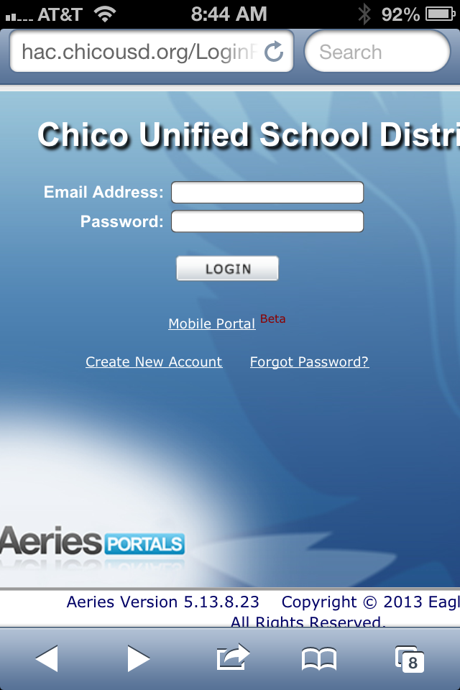
Aeries Mobile Portal For Parents and Students
Access for portable mobile devices
Go to hac.chicousd.org
Choose Mobil Portal (under the login button)

Slide 2
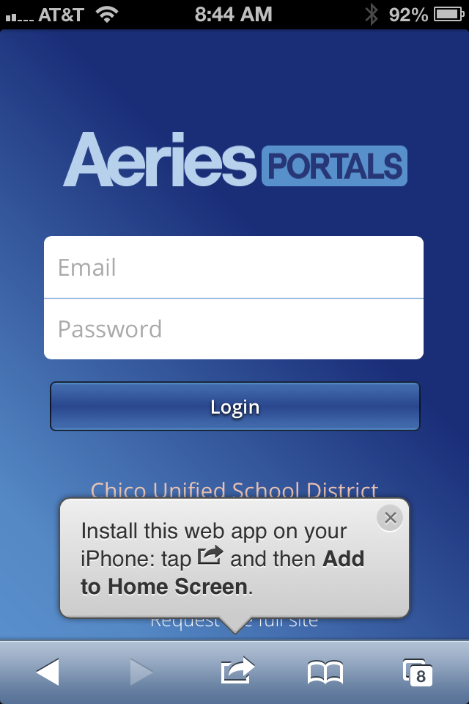
Aeries Mobile Portal For Parents and Students
Follow instructions in the gray caption box to install the web app on your Home Screen
Use existing Login information (or create an account with the required information)

Slide 3
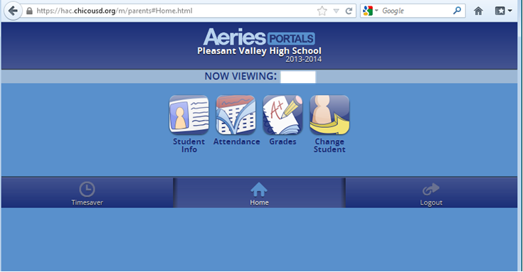
Toolbar Access to Student Info
New Feature: Set up grade checks that can be pushed out to you

